Slide 1
ABC Halloween Adventure
Click Here
Notes:
Goal: Make a Halloween game for Kindergarten students to play. Program buttons, sound effects, and animation triggers.
Step One: Edit the Cover Slide

Slide 2
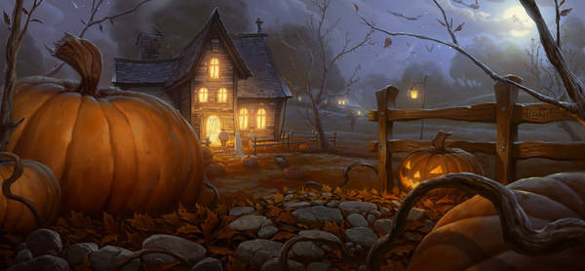
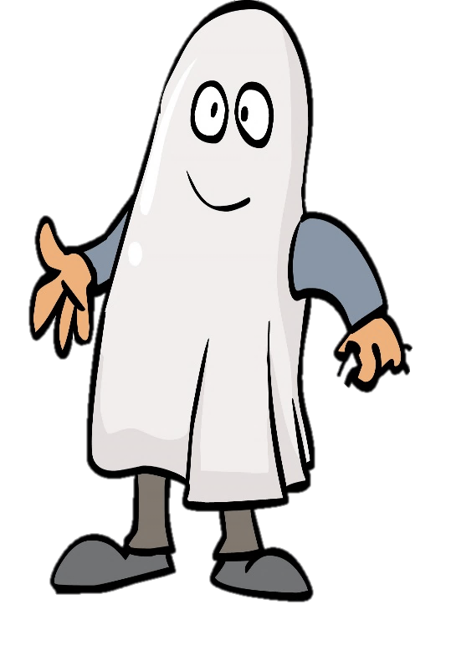
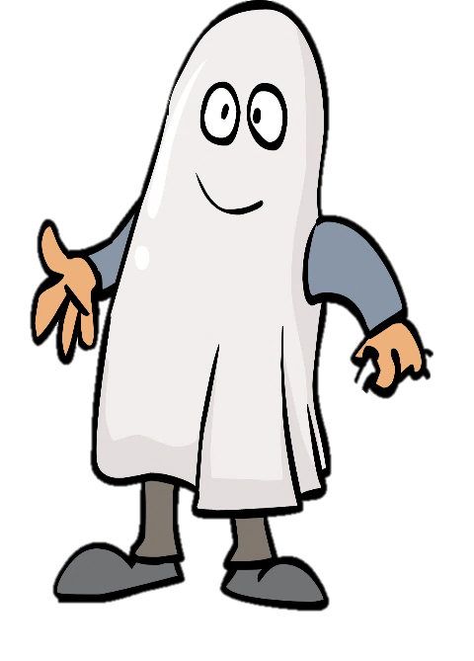
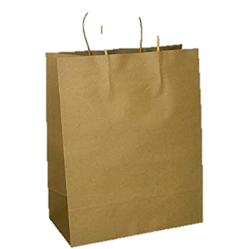
Click on the kids to see what treats they got!
Click here to continue
A
B
C
D
Notes:
Make Treats of the same Letter jump out of the bag and into the ghost’s hand when a user clicks on the bag. Use your animation trigger effects.
Bonus: Can you make the ghosts come in with an entrance animation?

Slide 3
Click here to continue
E
F
G
H
Notes:
Make treats of the same Letter jump out of the bag and into the ghost’s hand when a user clicks on the bag. Use your animation trigger effects.
Bonus: Add fun sounds, and spooky treats to drop down.

Slide 4
Click here to continue
I
J
K
L
Notes:
Make treats of the same Letter jump out of the bag and into the ghost’s hand when a user clicks on the bag. Use your animation trigger effects.
Bonus: Add fun sounds, and spooky treats to drop down.

Slide 5
Click here to continue
M
N
O
P
Notes:
Make treats of the same Letter jump out of the bag and into the ghost’s hand when a user clicks on the bag. Use your animation trigger effects.
Bonus: Add fun sounds, and spooky treats to drop down.

Slide 6
Click here to continue
Q
R
S
T
Notes:
Make treats of the same Letter jump out of the bag and into the ghost’s hand when a user clicks on the bag. Use your animation trigger effects.
Bonus: Add fun sounds, and spooky treats to drop down.

Slide 7
Click here to continue
U
V
W
X
Notes:
Make treats of the same Letter jump out of the bag and into the ghost’s hand when a user clicks on the bag. Use your animation trigger effects.
Bonus: Add fun sounds, and spooky treats to drop down.

Slide 8
Click here to continue
Y
Z
Notes:
Make treats of the same Letter jump out of the bag and into the ghost’s hand when a user clicks on the bag. Use your animation trigger effects.
Bonus: Add fun sounds, and spooky treats to drop down.

Slide 9
Play again?
Notes:
Make treats of the same Letter jump out of the bag and into the ghost’s hand when a user clicks on the bag. Use your animation trigger effects.
Bonus: Add fun sounds, and spooky treats to drop down.

